Slide 1
Synoptic project 2023
By Joey and Nicholas

Slide 2
Problem identification
The problem is in the timely and consistent distribution of food with short shelf lives as well as having a larger variety and culturally sensitive foods
This problem is caused through lack of information/lack of affordability
Donations and surplus food is typically long lasting such as tinned foods, frozen foods or pasta.
e.g. Fatima and Nina note that it is difficult to get halal foods in Govan at reasonable prices
Adnan notes the lack of variety and culturally accessible foods in Govan

Slide 3
Our Solution
Our idea to try and resolve this problem is to create a website to display discounted items at local stores.
This site would basically be a search engine where someone could input what they are looking for and the site would show places where that item is.
This would not only allow people to acquire desired foods at more affordable prices, but would also benefit the shops who put stuff on the website, as it makes it more likely that items that would otherwise be thrown out, are sold

Slide 4
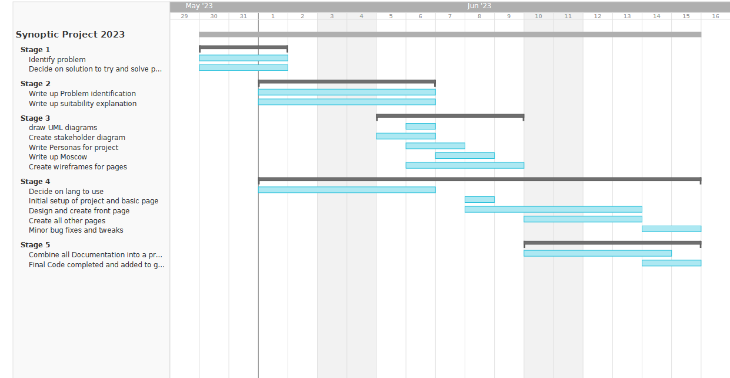
Gantt charts

Slide 5
MoSCoW
Must Have - way to view and add products
Must Have - Way to sort through products
Should Have - Access for featurephones
Should Have - Addresses for Shops/ longitude & latitude
Should Have - Low data/internet requirements
Could Have - Automated updating of products
Could Have - Ability to change ordering of results
Won’t Have - Maps/Directions
Won’t Have - Recommendations for shops

Slide 6
Persona: Abigal
Abigal is a Roma immigrant who came here a month ago. She currently relies heavily on the government Food stamps and food banks to support herself. She has a decent understanding of English, not fluent but enough to understand labels on products. She’s single, and most of her family remained in her home country. Due to her needs for food, she finds balancing getting sufficient food with food she finds important, such as pirogo. She also finds it hard to differentiate and is concerned that some supermarkets may be selling horse meat, which her culture forbids her from eating.
Goals
Eat a healthy balanced diet
Eat more of the foods she grew up eating (Romani foods)
Learn more English and communicate better

Slide 7
Persona: Hamza
Hamza is a poor British Muslim who’s lived in Govan all his life. He has consistent home and knows his way around the around but is poorly educated and struggles to get and hold a job. He relies on the food banks and stamps. He currently lives with his parents and his two siblings and so food is always fairly stretched. He would like to get a decent job and move out as well as cover the costs of his mobile device.
Goals
Get a decent job and hold it
Move out of his parents house
Use a small amount of data

Slide 8
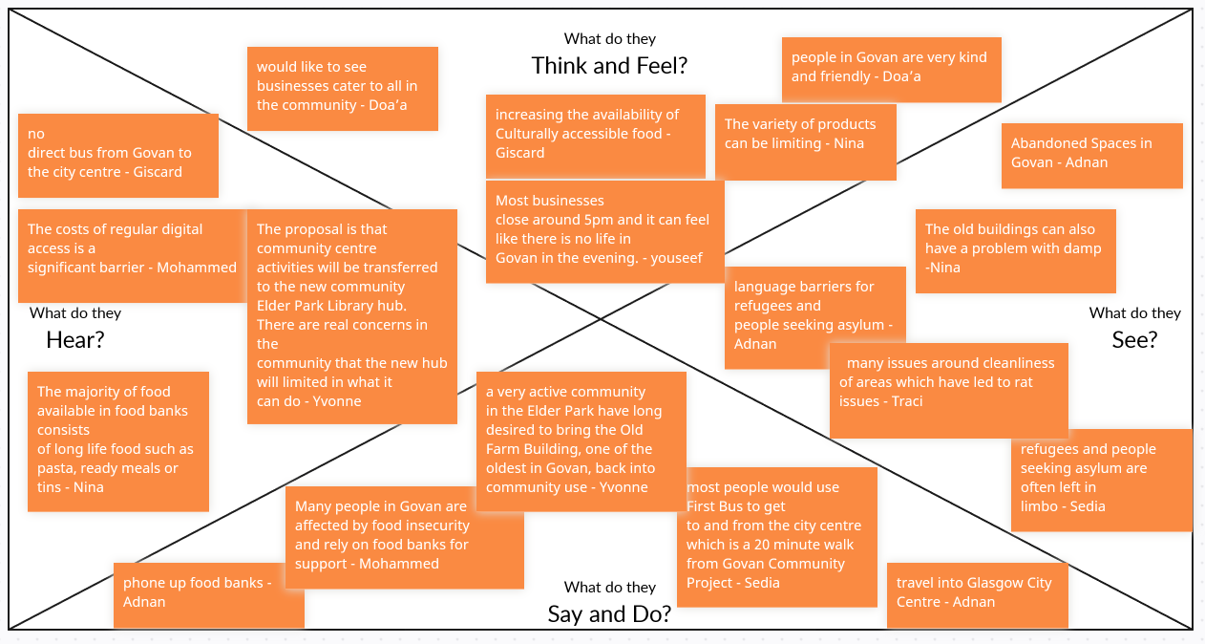

Slide 9
Stakeholders
Store owners– have an interest in selling more of their goods and having to throw away less
Local government – interest in improving the local situation to make it more attractive for new companies/ people to move there
Local People – have an interest in getting affordable food plus foods that fit in their culture and needs.
Food bank – help reach as many people as possible and have the best possible impact

Slide 10
User stories
As someone with specific dietary needs and low income I want to find out which local shops sell foods which I will eat at the best prices so that I can plan my shops effectively and use the least amount of time and money whilst achieving the best result.
Use acceptance criteria: Show local shops, product search functionality, shop search functionality, product update functionality

Slide 11
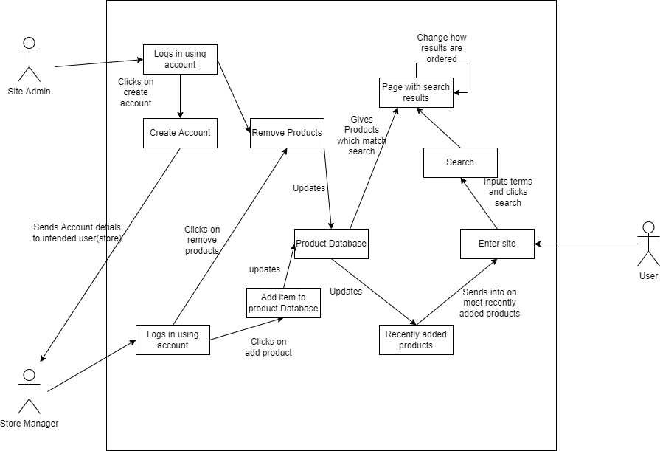
Use Case Diagram

Slide 12
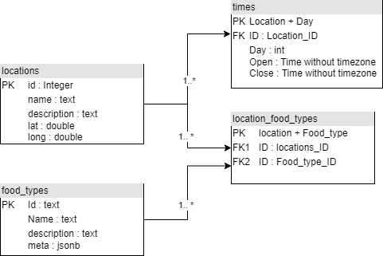
UML of database systems

Slide 13
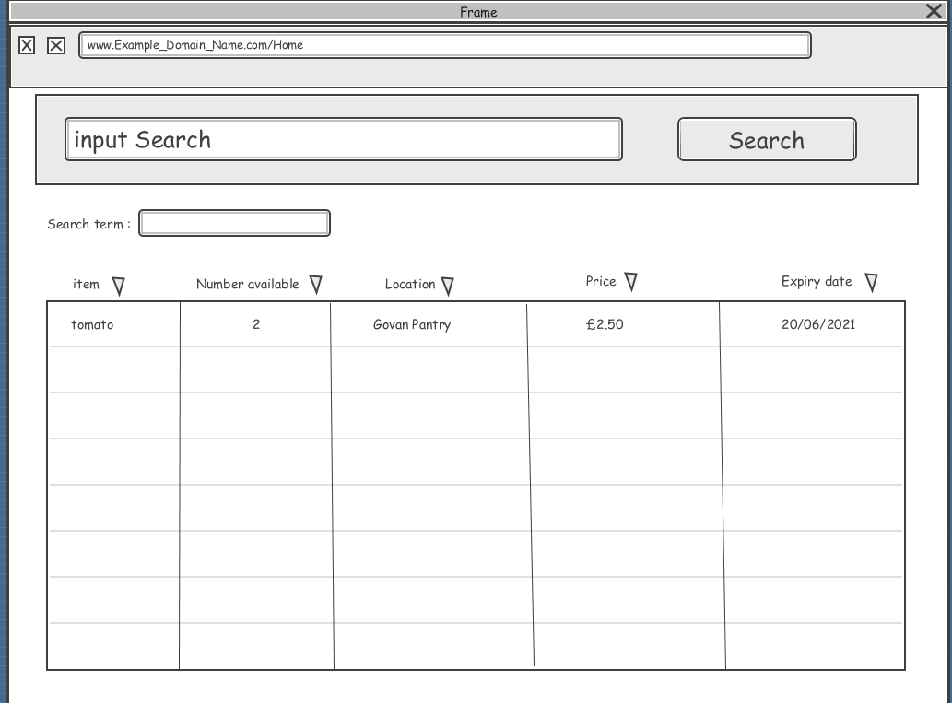
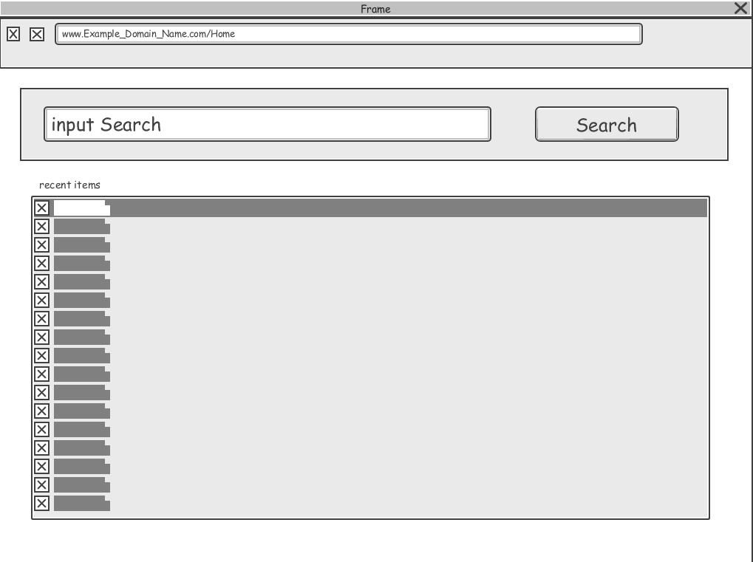
wireframes

Slide 14
User testing
2 people tried it
“it doesn’t really link together – all the pages are individual and not connected”
“The filter on the maps page was confusing and worked oddly”
“Why are there question marks in the filter tab”
“Something feels weird about the presentation in phone mode”

Slide 15
Future development
Not complete
Reduce necessity of internet access
Improve phone compatibility
Give options to add new items to shops

